Slide 1
Double Pipe Heat Exchanger Design

Slide 2
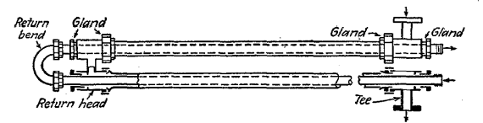
Typical construction
Concentric pipes fitted with packing glands and Tee – joint.
Multiple heat exchangers are connected with return bend and return head
Ref – Process Heat transfer by DQ Kern

Slide 3
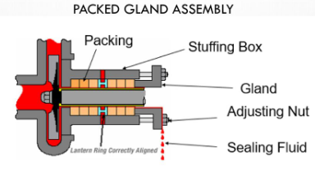
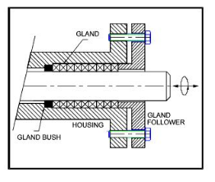
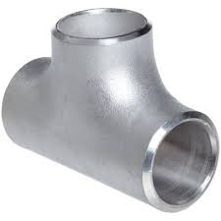
Packing glands and Tee joint
Packing glands
Tee joint
Ref: https://slideplayer.com/slide/11960513/,
https://www.brighthubengineering.com/marine-engines-machinery/65856-a-guide-to-gland-packing-part-two/

Slide 4
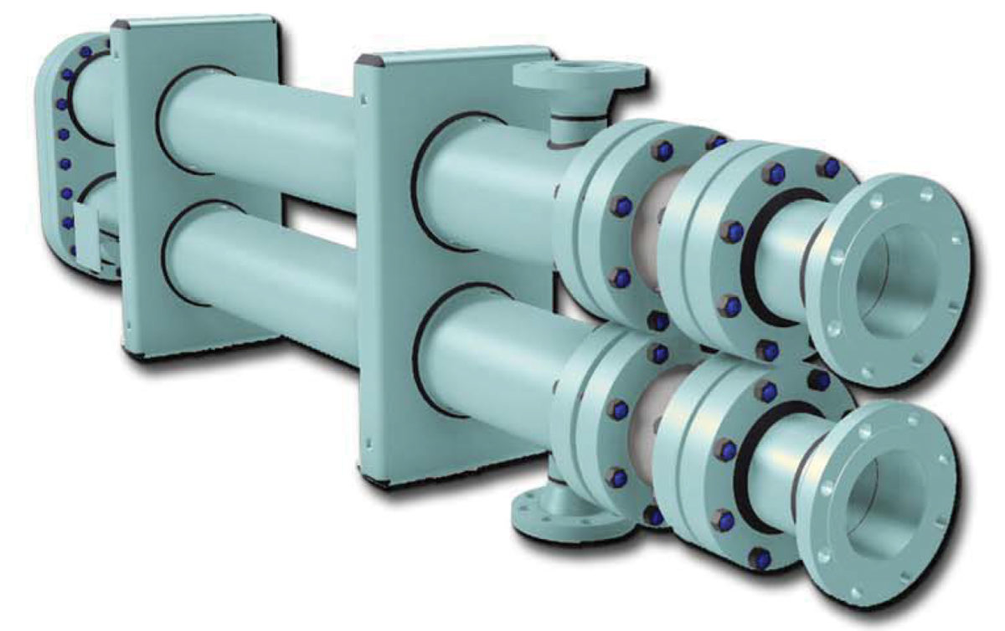
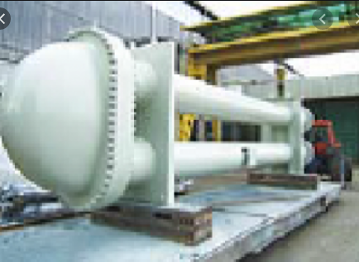
Typical commercial DHE

Slide 5
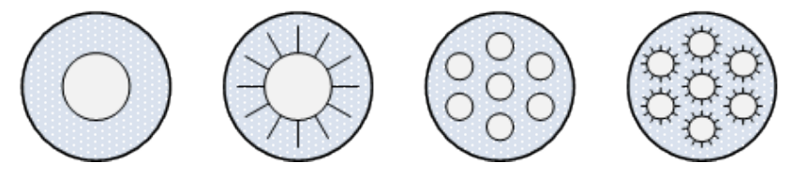
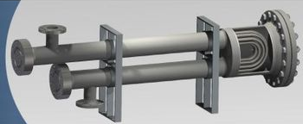
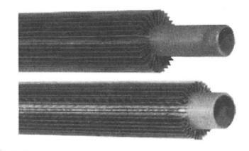
Configuration of inner tubes
Ref: https://www.energy-xprt.com/products/hairpin-heat-exchangers-66191
Double pipe heat exchanger design, MED, KAU

Slide 6
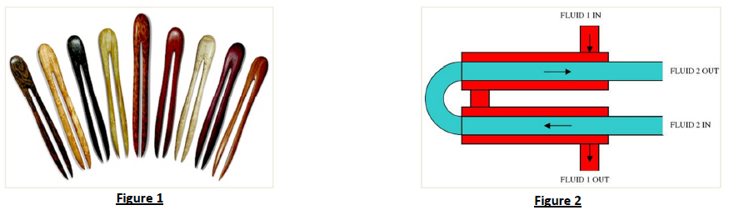
Hairpin Heat exchanger
It’s like a single-pass Shell &Tube unit that has been folded in half to give it a hairpin appearance.
For following conditions these can be an alternative to S&T exchangers:
Duty < 500 kW
Low Flow rates
Large Temperature cross
Diameter of S&T exchanger is 8" (200 mm) or less.

Slide 7
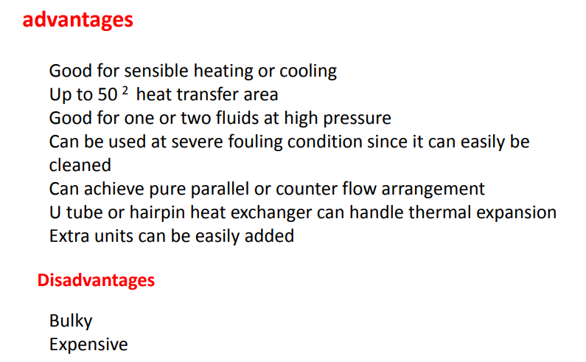
Pros and Cons

Slide 8
Points to ponder
Single tube DPHE
Shell tube size range - 50 - 150 mm (2” - 4”)
Inner tube size range - 19 - 65 mm (3/4” - 2.5”)
Multi tubular DPHE
No of tubes – commonly 7 but can go up to 64
Shell tube size range – 150 to 200 mm
Finned tube DPHE
Fins can provide about 2.5 times the external surface area
h_{shell} < 0.75 h_{tube}

Slide 9
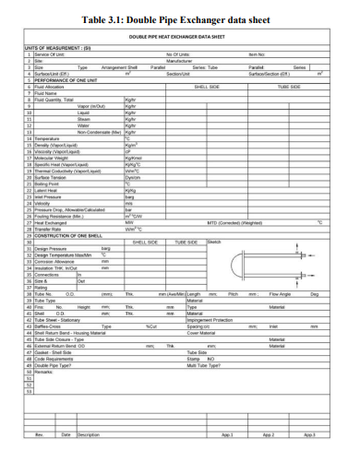
Data Sheet

Slide 10
Shell and tube side fluids
Shell Side | Tube Side
High Temperature fluid | More viscous fluid
Dirty and fouling fluids | Liquid with lower flow rate
More hazardous or expensive fluid | Fluid undergoing phase change e.g. condensing steam/vapor
Corrosive fluid | Fluid with large ∆T (>40ºC)
Streams with low flow rates | Fluid for which pressure drop limit is lower
 | Fluid that has poorer heat transfer characteristics

Slide 11
Design Considerations
HEs shall be designed to conform to specified shell side or tube side design pressure drop
P_{design, min} should be 10% above P_{operating, max}
Maximum operating pressures
Shell side – 165 bar
Tube side – 1033 bar
Tube elements shall be removable without cutting the shell or connecting piping and without disconnecting the shell piping.

Slide 12
Typical design problem
Known data pf two fluid streams
Hot fluid –T_{h,i} , flow rate - Known
Cold fluid – T_{c,i} , flow rate -
Design target variables could be - T_{h,o} and/or T_{c,o}
Properties
Allowable ΔP
Any other restrictions
HE need to be designed

Slide 13
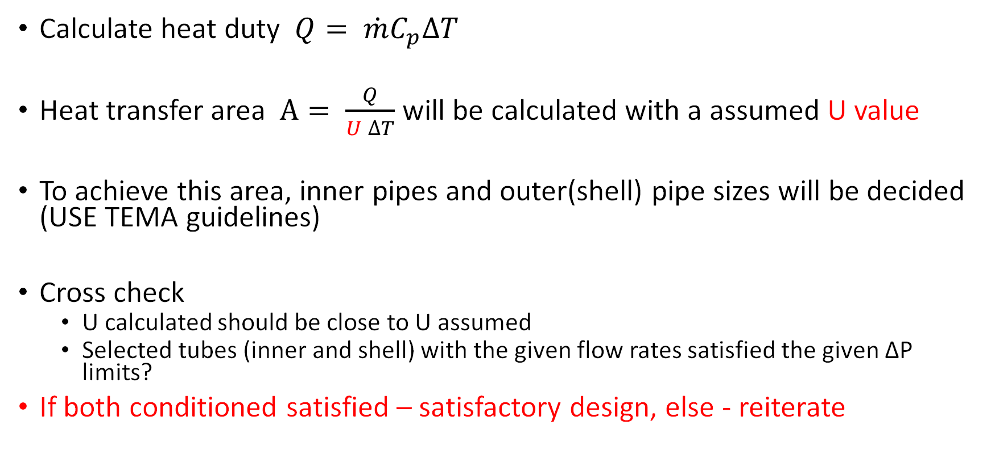
Key steps in design calculations
Calculate heat duty $Q= \dot{m}C_{p}∆T$
Heat transfer area $A= \frac{Q}{U ∆T}$ will be calculated with a assumed U value
To achieve this area, inner pipes and outer(shell) pipe sizes will be decided (USE TEMA guidelines)
Cross check
U calculated should be close to U assumed
Selected tubes (inner and shell) with the given flow rates satisfied the given ΔP limits?
If both conditioned satisfied – satisfactory design, else - reiterate

Slide 14
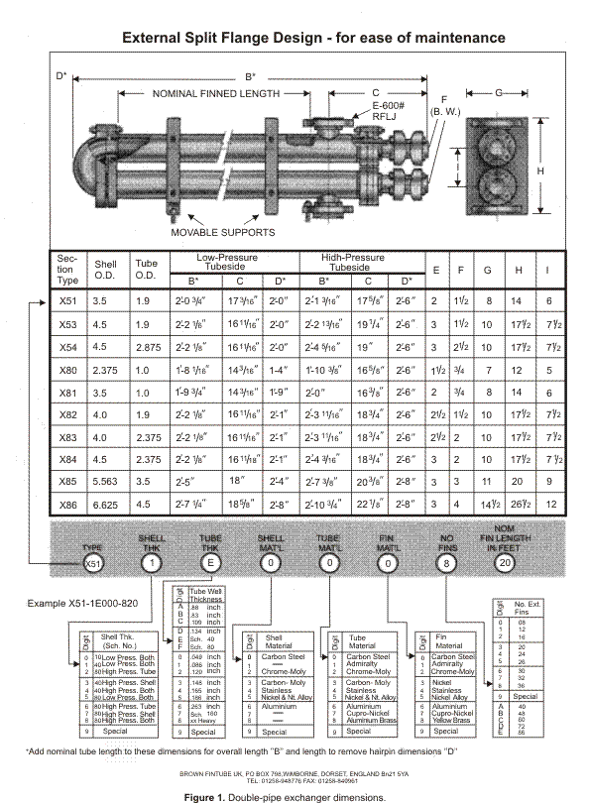
TEMA guidelines
Ref: http://www.thermopedia.com/content/705/

Slide 15
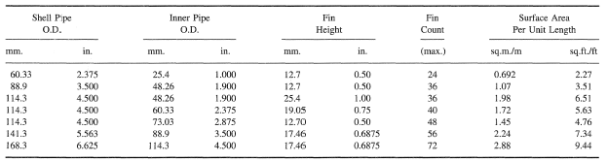
Double pipe hairpin section data
Ref: http://www.thermopedia.com/content/705/

Slide 16
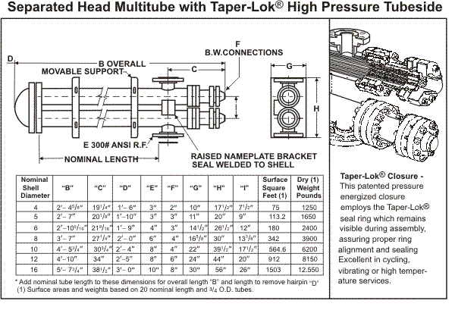
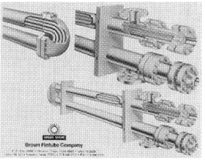
Multi tubular hairpins

Slide 17
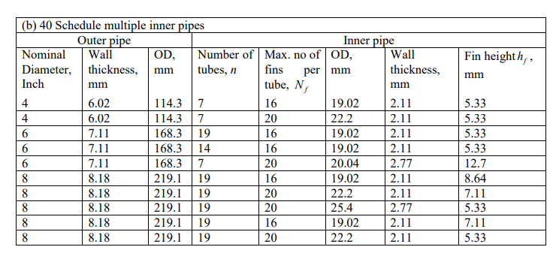
Multi tubular hairpins

Slide 18
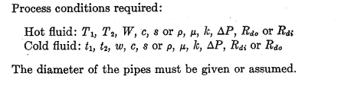

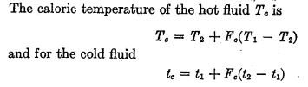



(3) Caloric temperatures T_{c} , t_{c}
If the temperature difference is 50 and viscosity is less than 1 cp, T_{c} , t_{c} can be taken as average temperatures

Slide 19
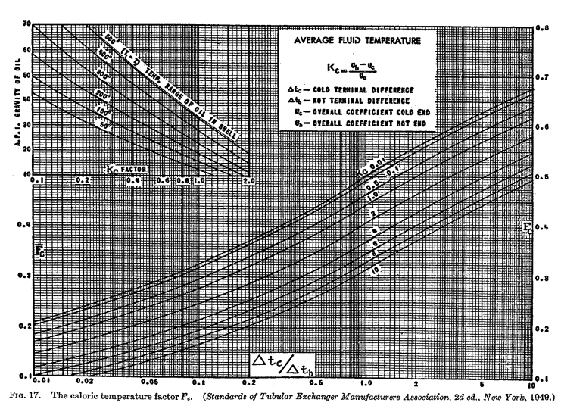

Slide 20
(4) Decide tube side and shell side fluid streams
(5) Estimate the tube side and shell side heat transfer coefficients using the correlations
Calculate j_{H} from the Figure 24 in the data book

Slide 21
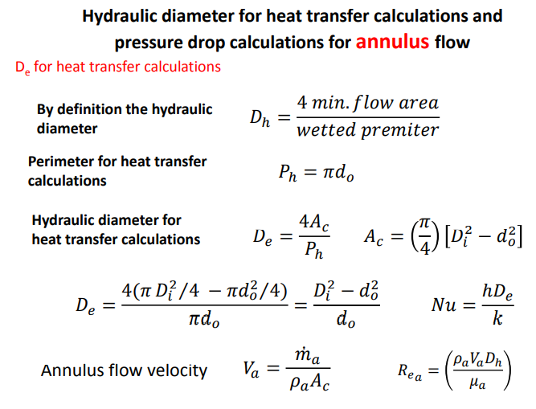

Slide 22
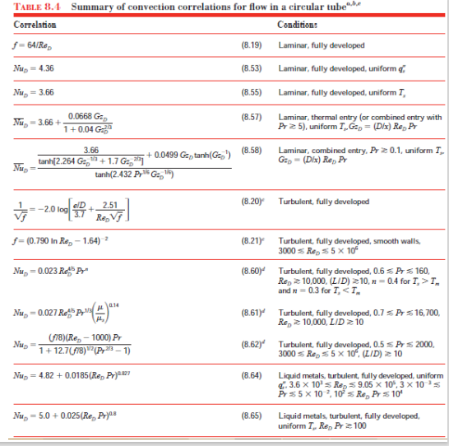

Slide 23

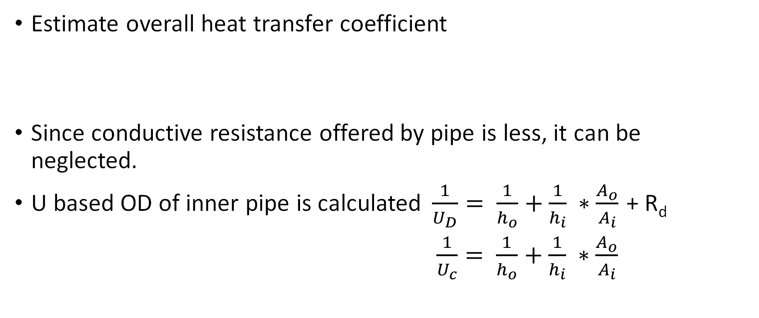
Estimate overall heat transfer coefficient
Since conductive resistance offered by pipe is less, it can be neglected.
U based OD of inner pipe is calculated$\frac{1}{U_{D}}= \frac{1}{h_{o}}+\frac{1}{h_{i}} ∗\frac{A_{o}}{A_{i}}$ + R_{d}
$\frac{1}{U_{c}}= \frac{1}{h_{o}}+\frac{1}{h_{i}} ∗\frac{A_{o}}{A_{i}}$

Slide 24
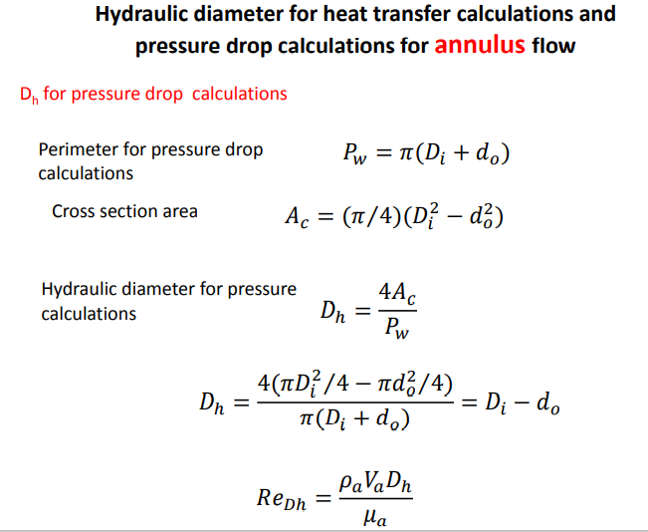

Slide 25
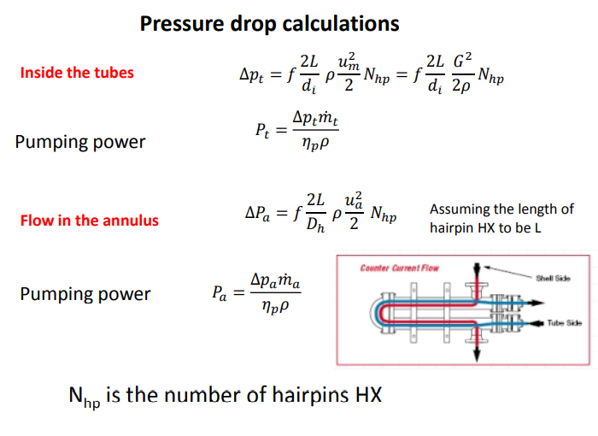

Entrance and exit losses, one velocity head per hair pin = $\frac{{ρu}^{2}}{2}$

Slide 26
Check
Calculated ΔP (for both tube side and shell side) should be with in the limits.
If this condition doesn’t satisfy we need use series-parallel combinations of hairpins.

Slide 27
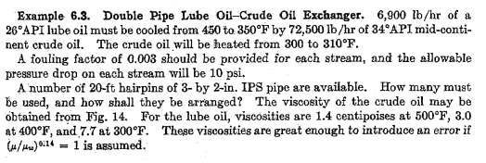
Pressure drop came to be 60 psi in the tube side

Slide 28
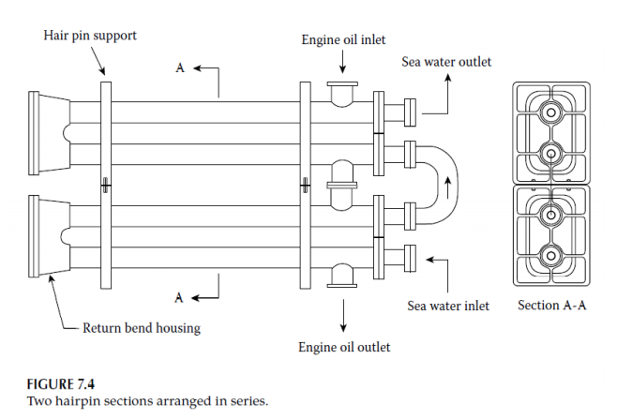

Slide 29
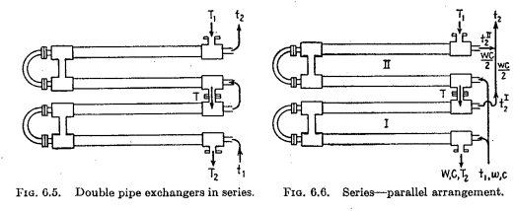

Slide 30
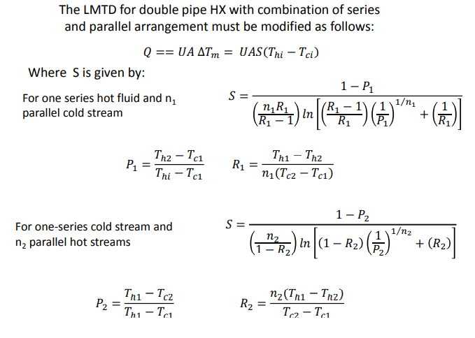
Pressure drop due elevation difference between inlet and outlet should also be included

Slide 31
References
Process Heat transfer by D Q Kern

